Slide 1
Reliability of Systems
Unit 9
Spring 2022

Slide 2
References
Ebeling, C.E., An Introduction to Reliability and Maintainability Engineering, 3rd ed, Waveland Press, 2019, Chapter 5 (Ebeling, IRME)
Modarres, M., M. Kaminskiy, and V. Krivtsov, Reliability Engineering and Risk Analysis, 2nd ed, Taylor&Francis, 2010 (Modarres, RERA)
Norman Fenton and Martin Neil, “Risk Assessment and Decision Analysis with Bayesian Networks,” CRC Press, 2019, 2nd ed., Chapter 14 (RDBN, 2019)
Jordaan, Ian, Decisions Under Uncertainty– Probabilistic Analysis for Engineering Decisions, Cambridge University Press, 2005 (Jordaan, 2005)
Modarres, M., Risk Analysis in Engineering, Taylor&Francis, 2006 (Modarres, RAE)
Modarres, M., Reliability Engineering and Risk Analysis in Engineering, Marcel Dekker, 1999 (Modarres, RE)
O’Connor, P.D.T., Practical Reliability Engineering, 4th ed, Wiley, 2002 (O’Connor, PRE)
Rausand, M. and Hoyland, A., System Reliability Theory, 2nd edition, Wiley, 2004

Slide 3
Summary
Various System Configurations to be considered:
Series Configuration
Parallel Configuration
Combined Series-Parallel Configuration

Slide 4
Serial Configuration
System Reliability: R_{s} = P{E₁ ⋂ E₂} = P(E₁|E₂)P(E₂)
where E₁ and E₂ are events that components 1 and 2 does not fail
Assuming independence of E₁ , E₂:
R_{s} ~ P{E₁} P{E₂} = R₁⋅R₂
System Reliability of n units in series follows the AND gate
System Failure of n units in series follows the OR gate
Notes:
Components within a system can be related in a serial or parallel fashion. If n components are serially related then the failure of any one (or more) of the components results in a system failure. This leads to the multiplicative relationship of their reliability functions to the system reliability. Applying some basic rules of probability theory under the independence assumption leads to this result. By the way, the diagram showing the serial relationship is called a reliability block diagram. This is a useful way of depicting the reliability configuration of the system.

Slide 5
Multiple Components in Series
Generalizing to n independent components in series:
R_{s}(t) = R₁(t) ⋂ R₂(t) ⋂ ... ⋂ R_{n}(t) (General expression) R_{s}(t) = R₁(t).R₂(t) ... .R_{n}(t), if all R_{i}(t) (If independent)
Thus, System Reliability is the Pr that component 1 is working AND Pr that component 2 is working AND…
Because the reliability of each component is < 1, the System Reliability (obtained from multiplying all component reliabilities), can be no greater than the smallest component reliability:
R_{s}(t) ≤ min {R₁(t), R₂(t), ..., R_{n}(t)}
So, in series, system reliability is less than that of the least reliable component (the weakest link in the chain!)
Notes:
At time t, for the system to be functioning each of components must be functioning. Since R_{i}(t) is the probability that the i^{th} component is functioning at time t, then the product of all n reliabilities gives the desired result (i.e. component 1 is functioning, component 2 is functioning, component 3 is functioning etc.). State in words the meaning of the above inequality. Why is it true?

Slide 6
Component Count vs. System Reliability
Independent Components in Series
Reliability 10 100 1000
0.900 0.349 0.266x10⁻⁴ 0.175x10⁻⁴⁵
0.950 0.599 0.00592 0.529x10⁻²²
0.990 0.904 0.366 0.443x10⁻⁴
0.999 0.990 0.905 0.368
For Systems with a large number of components in series, the individual components must generally have high reliability for the System to be acceptably reliable.
Notes:
Multiplication in action: For systems having a large number of components, the individual component reliabilities must be large for the system to be reliable.

Slide 7
Constant Failure Rate Components Connected in Series
If all system components are CFR (or Exponential), the System of independent components in series is also Exponential
MTTF_{S} = 1/λ_{S}
Notes:
If all the components are exponential (CFR), then the system is also exponential. A result we had seen earlier.

Slide 8
Weibull Components Connected in Series
If the System components are all Weibull, the System of the independent components in series may or may NOT be Weibull. State the component shape factor specification for the System to be Weibull.
Individual component reliability:
System reliability:
System failure rate:
In series, the system failure rate is the summation of all component failure rates
Notes:
If all the components are Weibull, then the system is not necessarily Weibull. Do you recall under what conditions, the system will be Weibull?

Slide 9
Components in Series - Example
A communications satellite consists of the following components in series:
Component Distribution Parameter β Characteristic Life, θ
Power unit Weibull 2.7 43,800 hr
Receiver Weibull 1.4 75,000 hr
Transmitter Weibull 1.8 68,000 hr
Antennae Exponential MTTF = 100,000 hr = 1/λ
Given independence, state the expression of system failure rate and calculate the reliability of this system at 2 yr (17,520 hr).
(Ebeling, IRME)
Notes:
In general, components can have a variety of distributions. Regardless, if we multiply their reliabilities we will get the system reliability. Without looking ahead, what is the system reliability at two years (17,520 hours at 24/7)?

Slide 10
Independent Components in Series: Example
Weibull
Weibull
Weibull
Exponential
General expression for calculating the MTTF:
Weibull:
For any System:
Variance =
Notes:
Is the reliability acceptable? How would you find the system MTTF? Don’t find it, just think about how to find it.

Slide 11
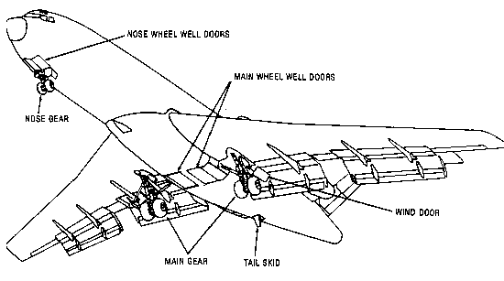
Class Exercise
The failure distribution of the main landing gear of a commercial airliner is Weibull with a shape parameter, β = 1.6, and a characteristic life, θ = 10,000 landings.
The nose landing gear also has a Weibull distribution with a shape parameter of 0.90 and a characteristic life of t = 15,000 landings (instead of time units).
Assuming independence of the main and nose landing gears, what is the Reliability of the landing gear System at 1,000 landings when the System is to be overhauled?
First define the landing gear System and state whether it is a series or a parallel System. Then write an expression to model the Reliability of the System, R(t).
Notes:
This would seem like an important reliability to know. Can you find what it is?

Slide 12
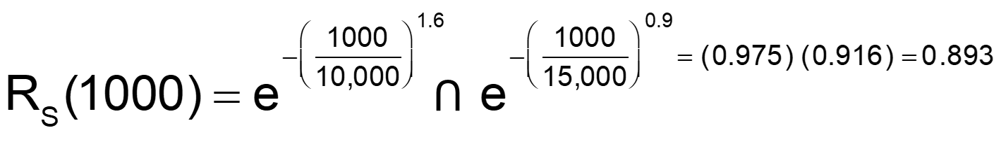
Class Exercise - Solution
This is a Series System!
Main landing gear
Nose landing gear
Landing gear System:
Notes:
Perhaps we should schedule overhauls more frequently. Can we assume that an overhaul of the landing gear system will restore it to “as good as new.” That is, we set the time clock on the system back to zero. If not, what can we conclude?

Slide 13
Class Exercise, Series System, CFR
Determine System parameters for 3 independent units in series. For the following constant failure rates λ_{i}, calculate the following, where t = 1,000 hr.
Begin by stating the Weibull β value.

Slide 14
Series System Solution CFR
Weibull β value = 1, Exponential
independent
λ_{s} larger than any λ_{i}
λ_{s} is larger than any λ_{i} , so MTTF_{s} must be smaller than any MTTF_{i} :
Is the series System behavior what you expect (λ_{s} compared to λ_{i} or MTTF_{s} vs MTTF_{i})?

Slide 15
Dependencies within a Series System
If there is one or more significant dependencies among System components, the reliability and MTTF values will often be significantly lower than calculated, so λ_{s} will be higher than calculated from the simple model that assumes independent units.
Consider the Cardinal Rule that everything is dependent on time: Are the measured reliability values consistent with the calculated estimates, or should the λ values or approximations (λ constant or behavior independent) be revised based on the measured values?

Slide 16
Parallel System: Review
1
2
. . . .
N
System Failure is based on failure of all units in parallel: AND gate.
If all units in a parallel System can be modeled to perform independently, then the ⋂ operator can be estimated by multiplication:
System Failure of n units in Parallel follows the AND gate.

Slide 17
Parallel Configuration Review
System Reliability, R(t) of a parallel configuration is found by calculating first the Pr that all components fail, F(t), and then subtracting F(t) from 1.
Assume E₁, E₂ independent
R_{s} = 1 - (1-R₁) (1-R₂)
R_{s}(t) = probability that at least 1 component out of n in parallel does not fail!
Notes:
A parallel or redundant relationship among components will require that all parallel components fail before the system will fail. The easiest way to find the system reliability is to first compute the probability that all components fail and then subtract that number from one (1.0). Why does this work?

Slide 18
Parallel Configuration - Generalization
General expression for OR gate calculation for independent units
Note that the product of the quantity in brackets above is less than the failure probability of the most reliable component. Therefore, R_{s}(t) is at least as large as the most reliable component.
R_{s} (t) ≥ max {R₁(t), R₂(t), …, R_{n}(t)}
This inequality is true because with n components in Parallel there are n paths to success and 1 path to failure compared to a Series configuration, where there is one path to success and n paths to failure
Notes:
What is the quantity in brackets? What is its product? State in words the meaning of the inequality. Give at argument showing why it is true?

Slide 19
Parallel Configuration – 2-component CFR Model
assuming independence
For n = 2:
λ reduced by 50%; MTTF increased by 50%
Notes:
For n parallel components having exponential distributions, the system failure distribution will not be exponential. Observe how easily the system MTTF is derived by integrating the system reliability function. We will see more of this in the next chapter. Now write simplified expressions for R(t) and the MTTF if all components have the same constant failure rate.

Slide 20
Exercise, Parallel System
Determine System parameters of 3 independent units in parallel. For the following constant failure rates, calculate the following, where t = 1000 hr:

Slide 21
Solution, Parallel System
Assume the Exponential reliability distribution. Why?
OR gate expression, independence
Leading Term
Taylor Series
e^{-λt} ~ 1-λt , λt << 1
How does this follow?
Note the lower F_{s}(1000 hr) compared to F_{i}(1000 hr).
Is this System behavior is expected?

Slide 22
Solution, Parallel System
Determine parameters of a System of 3 units, assumed to be independent, with constant λ in parallel.
λ_{s} = 1/MTTF_{s} = 2.3x10⁻⁶, smaller than any λ_{i} MTTF_{s} > MTTF_{i}

Slide 23
Parallel System of N Blocks
Mean time to failure for N parallel units.
In general, MTTF_{s} and reliability increases as additional parallel components are added, but the rate of gain in reliability decreases as N grows larger.
How do you decide how many redundant components you will use?
- Compare how much is gained by an increased number of units and increased cost. Is the cost sufficiently balanced by the gain?

Slide 24
How many redundant components?
In a redundant System of N independent units in parallel, if all units have a constant λ_{i} and λ_{i} ~ λ:
For design of redundant Systems, MTTF_{s} > MTTF of each unit, but as N increases, each additional unit adds less to System reliability, and cost increases.
Calculate optimum number of parallel units to maximize reliability and minimize overall cost during the unit life cycle (initial cost, maintenance costs). Without acceptable quality of test and maintenance, the System redundancy will be lower than expected.
increase by 50% with 2nd unit

Slide 25
Dependencies, Parallel System
A parallel System of 2 or more units, assuming independence, can exhibit higher reliability than a single 1 unit.
Because units are generally dependent to some degree, this ideal model assuming independence provides an upper limit estimate of System reliability and also highlights the importance of monitoring component reliability and identifying significant dependencies.

Slide 26
Redundancy Reducers
Internal dependencies can arise from
Physical, shared hardware
Equipment with same defect
Functions with same deficiencies
Extreme conditions
Same human error for all components, such as poor maintenance for all components
External
Human and Organizational errors
Delays in parts, Supply and Administration Delays (SAD) for repairs & maintenance
Environmental conditions

Slide 27
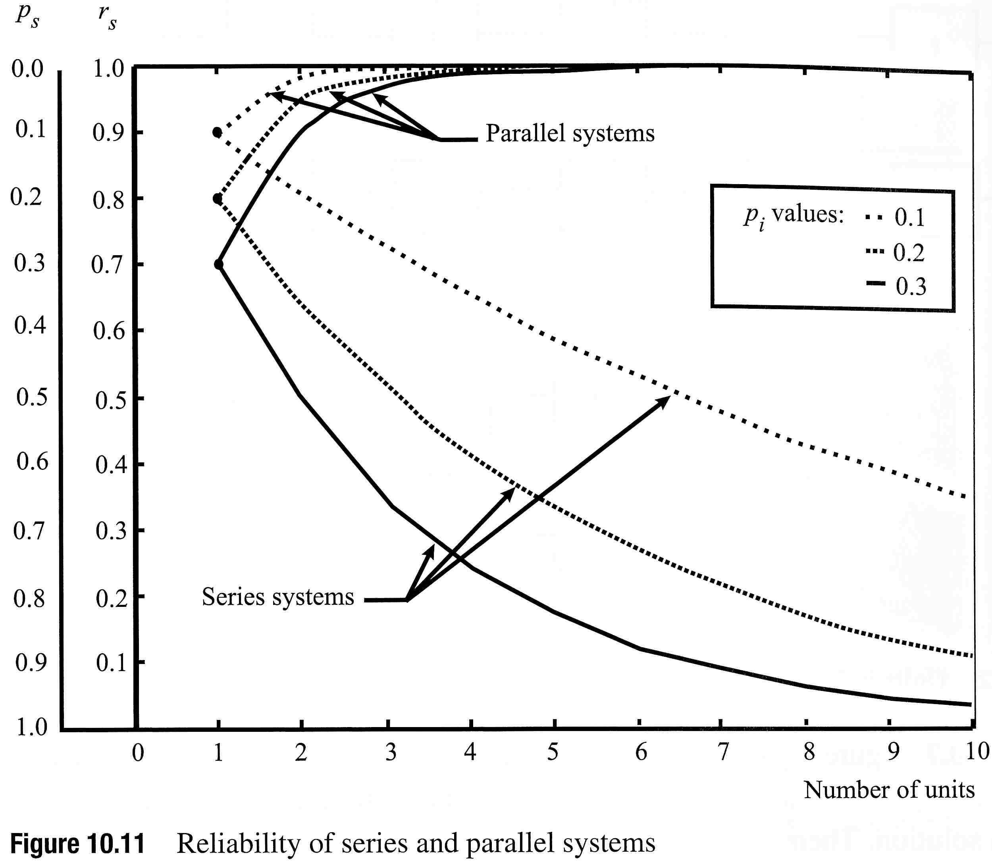
System Units in Series and Parallel
The reliability increases for the units in parallel, because as the number of parallel units increases, an increasing number of units must fail for the System to fail as there are n paths to success.
As the number of units increases in a series System, the number of ways the system can fail increases, n paths to failure, so the System reliability drops as the number of units increases.
F_{i}(t) = p_{i}
(Jordaan, 2005)

Slide 28
Combined Series - Parallel Systems
R₁
R₃
R₂
R₆
R₄
R₅
Break the System into sub-assemblies of 2 or more (independent) components that are either in series or parallel. Then combine the sub-assemblies.
(Ebeling, IRME)
Notes:
“What happens if a system has both serial and parallel relationships among the components,” you ask. We attempt to break the system down in sub-assemblies consisting of two or components that are all either serial or parallel related. Then we put the sub-assemblies together that are all either serial or parallel related, etc. But wait, this is best illustrated by an example. Use the animation on the next several slides to see how this reliability network is solved.

Slide 29
Combined Series - Parallel Systems
Calculate A of two units in parallel, then B with two units in series, then C with two units in series, then B and C in parallel, and finally with R₆ is series.
B
A
R₁
R₃
R₂
R₆
C
R₄
R₅
(Ebeling, IRME)
Notes:
“What happens if a system has both serial and parallel relationships among the components,” you ask. We attempt to break the system down in sub-assemblies consisting of two or components that are all either serial or parallel related. Then we put the sub-assemblies together that are all either serial or parallel related, etc. But wait, this is best illustrated by an example. Use the animation on the next several slides to see how this reliability network is solved.

Slide 30
Combined Series - Parallel Systems
A
R₁
R_{A} = [ 1 - (1 - R₁) (1 - R₂ )]
R₂
A
B
R₁
R_{B} = R_{A} R₃
R₃
R₂
(Ebeling, IRME)
Notes:
We first find the reliability of subassembly A. Then form subassembly B and find its reliability.

Slide 31
Combined Series - Parallel Systems
C
R₄
R₅
R_{C} = R₄ R₅
R_{B} = R_{A} R₃
R_{A} = [ 1 - (1 - R₁) (1 - R₂ )]
R_{B}
R₆
R_{C}
R_{s} = [1 - (1 - R_{B}) (1 - R_{c}) ] R₆
(Ebeling, IRME)
Notes:
Separately find the reliability of subassembly C. Now B and C are in parallel with their assembly in series with component 6. And you thought this was going to be hard!

Slide 32
Example 1: A Common Everyday Reliability Block Diagram to Solve
R_{E}=0.7
R_{A}=0.8
R_{D}=0.95
R_{F}=0.8
R_{B}=0.9
R_{C}=0.9
0.81
1-(1-0.7)(1-0.8) = 0.94
1-(1-0.8)(1-0.81) = 0.962
R_{s} = (0.962) (0.95) (0.94) = 0.859
Help! Where can I find
a common everyday
reliability block diagram?
(Ebeling, IRME)
Notes:
Here is a typical, common everyday reliability block diagram. What is the system reliability? Be sure you can solve this type of a problem before you continue to the next exciting chapter!

Slide 33
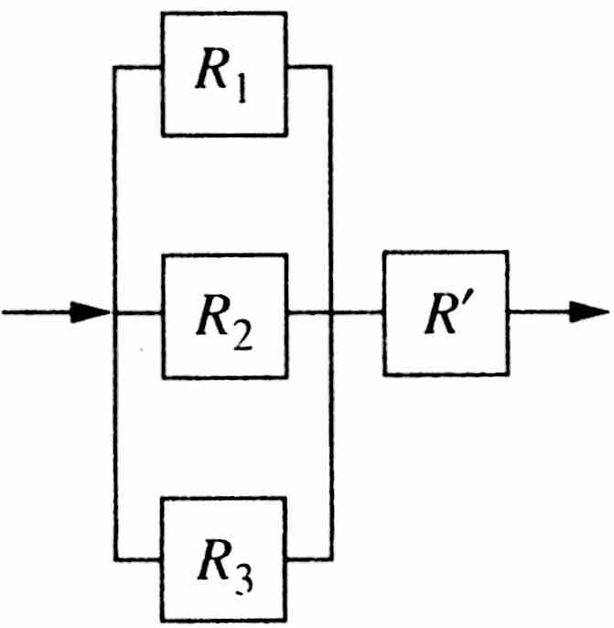
Example 2: Common Mode/Dependent Failures
Common Mode failures involve more than one unit of the same or similar component due to dependence on effects or conditions that the same or similar components are sensitive to.
A common mode failure can be modeled in series with one or more components, as shown in the figure below with 3 components in parallel, where the predicted System Reliability is decreased by a previously measured common-mode failure probability. This is an example of including dependency that reduces the achieved redundancy in a parallel configuration.
R’ in series with redundant components

Slide 34
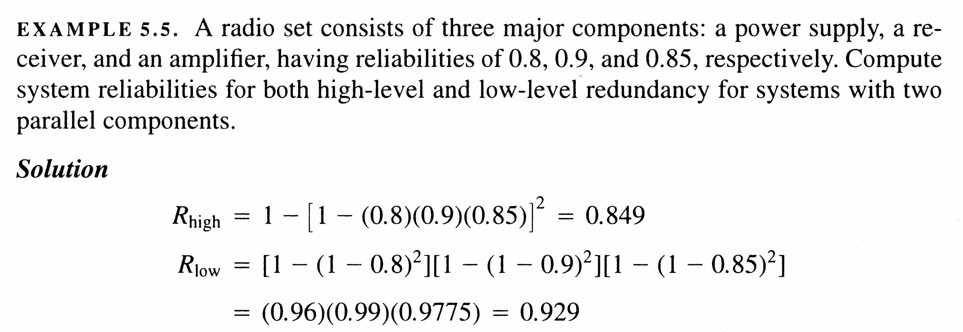
Example 3: High-Level, Low-Level Redundancy
2 parallel units of 3 components in series
Series system of 3 units, each with 2 redundant components
> R_{high}
(More paths to Success)
A
B
C
A
B
C
A
B
C
A
B
C
High Level Redundancy
Low Level Redundancy
(Ebeling, IRME)

Slide 35
K-out-of-N Redundancy
Let n = the number of redundant, independent and identically distributed (iid) components each having a reliability of R
Let X = the number of components (out of n components) that need to operate.
We know from the Binomial distribution that the probability of x successes among n independent trials is given by:
If k or more components must operate for the system to operate, System reliability is:
often easier to calculate
Notes:
A generalization on the concept of redundancy is to require any k of the n components to operate for the system to operate. In other words, there is a minimum number, k, that must not fail. When the N-k+1 component fails then the system fails. If all components are identically distributed, then the reliability can be found using the binomial probability distribution. Recall that the a binomial random variable is defined to be the number of successes among n independent trials. A trial is a component and a success is operating at time t.

Slide 36
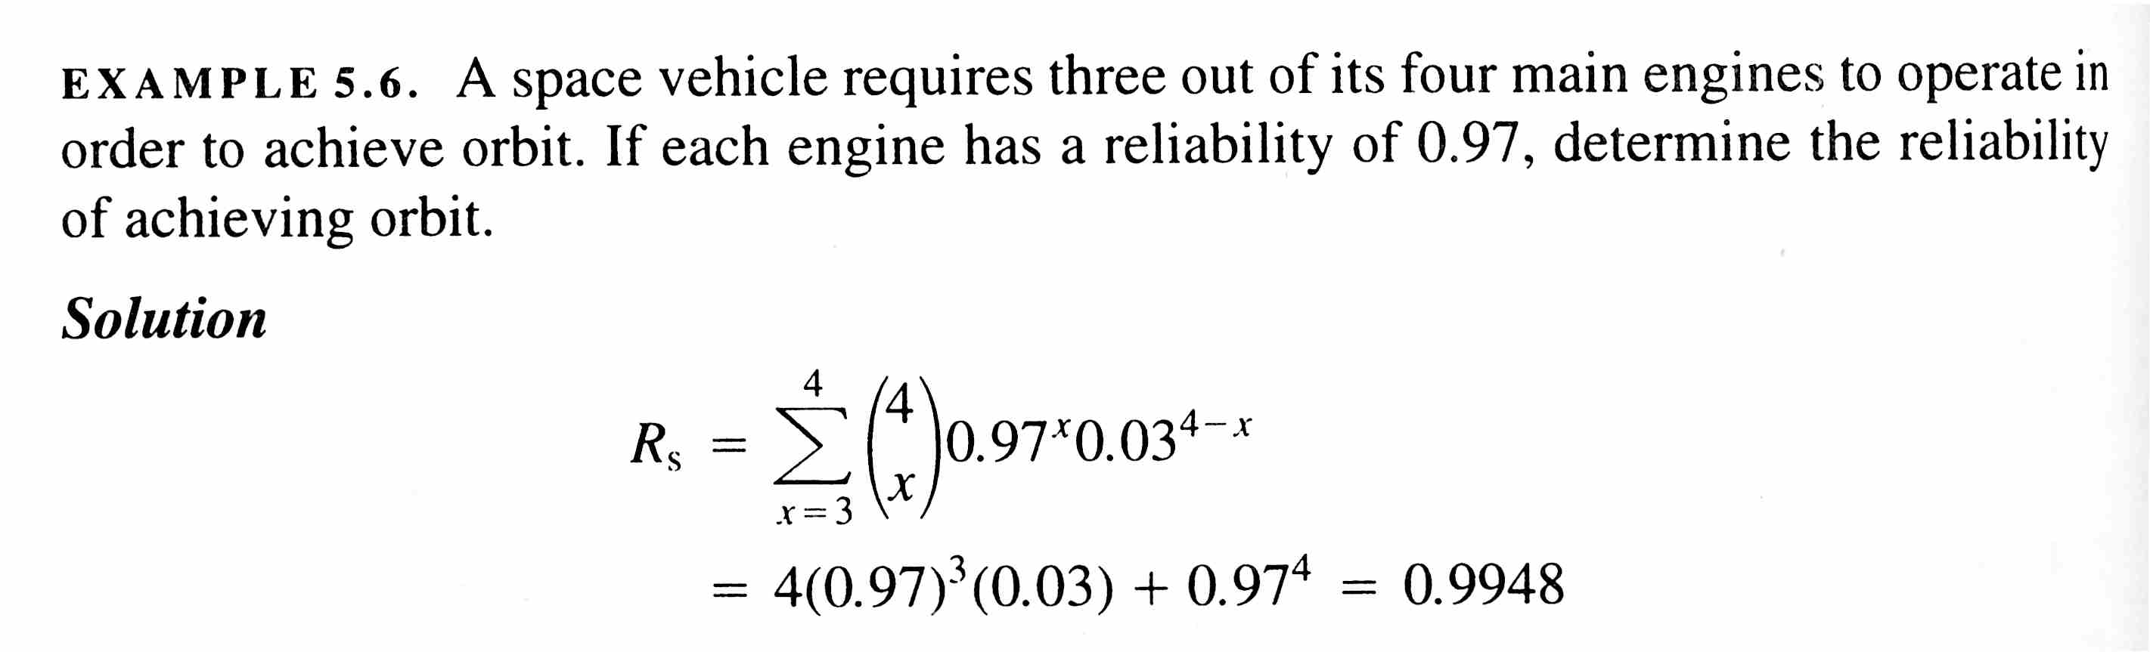
Example 4: K-out-of-N Redundancy
(Ebeling, IRME)

Slide 37
Example 5: A Good Example of K out of N Redundancy
Out of the 12 identical, redundant, and independent AC generators on a C-5 aircraft, at least 9 of them must operate for the aircraft to complete its mission.
Assume that AC generator failures are known to follow an Exponential distribution with MTTF= 100 operating hours. What is the AC generator λ?
What is the Reliability of the generator System of 12 generators over a 10-hour mission? What must you calculate first to use the K out of N expression?
Find the MTTF of the System and compare it with the MTTF of each generator.
(Ebeling, IRME)
Notes:
Test your understanding on this example.

Slide 38
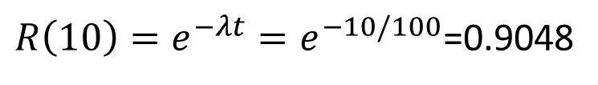
A Very Good Solution
λ=1/100
Let T_{i} = time to failure of the i^{th} generator
$R\left(10\right)=e^{−λt}=e^{−10/100}$=0.9048
The generator System is represented by an Exponential distribution with constant λ. Therefore,
(Ebeling, IRME)
Notes:
Doesn’t it feel good when you get the correct answer?

